Slide 1
AZ-400.00 Learning Path 07: Design and implement a dependency management strategy

Slide 2
Agenda
Module 01: Explore package dependencies.
Module 02: Understand package management.
Module 03: Migrate, consolidating and secure artifacts.
Module 04: Implement a versioning strategy.
Module 05: Introduction to GitHub Packages.
Labs & Learning Path review and takeaways.

Slide 3
Module 01: Explore package dependencies

Slide 4
What is dependency management?
1
Modern software is complex
2
Component based development is common
3
Not all software is written by a single team
4
Dependencies on components created by other teams or persons

Slide 5
Describe elements of a dependency management strategy
Standardization
Package formats and sources
Versioning

Slide 6
Identify dependencies
Find components and source code that can have independent:
Things to consider:
Deployment
Release
Versioning
Change frequency
Changes should be unrelated to other parts of system
Can package exist by itself
Package should add value for others

Slide 7
Understand source and package componentization
1
Source componentization:
Split out components
Related projects in different solutions
2
Package componentization:
Composing your solution to use packages

Slide 8
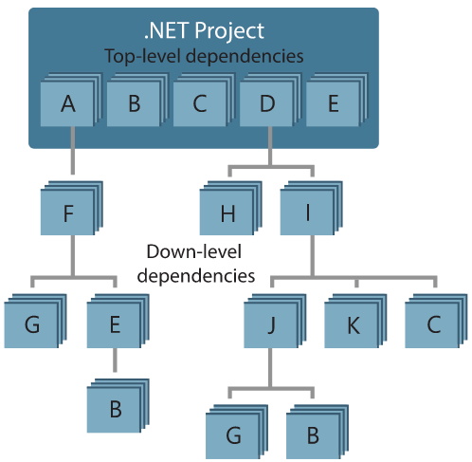
Decompose your system
Approach:
Draw a dependency graph
Group components in sets of related components
Few spanning check-ins across sets
Ideally a single team is responsible
Shared release cadence for single set

Slide 9
Module 02: Understand package management

Slide 10


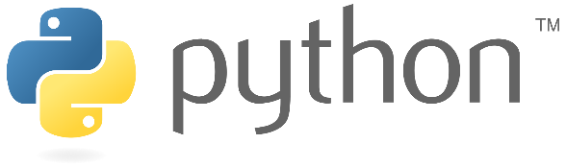

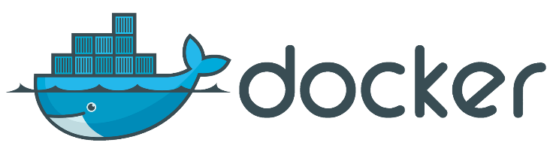
Explore packages
A package is a formalized way of creating a distributable unit of software artifacts that can be consumed from another software solution.
Microsoft platform
and .NET artifacts
Node.js modules
Python modules
Universal packages
Java packages
Docker images

Slide 11
Understand package feeds
Centralized storage of package artifacts:
Public or privately available
Offer secure access for private feeds
Versioned storage of packages
Managed by tooling
Also known as:
Package repositories
Package registry
Package types:
Public: NuGet.org, Npmjs.org, PyPi.org, Docker Hub
Private: MyGet, Azure Container Registry, Azure Artifacts, Self-hosted solutions

Slide 12
Explore package feed managers
1
Manage feeds
2
Search and list packages from feed
3
Consume packages
4
Maintain local installation cache
5
Publish packages
6
Choose tooling:
Command-line tooling
Integrated in build and release pipelines

Slide 13
Explore common public package sources
NuGet Gallery
https://nuget.org
NPMjs
https://npmjs.org
Maven
https://search.maven.org
Docker Hub
https://hub.docker.com
Python Package Index
https://pypi.org

Slide 14
Explore self-hosted and SaaS based package sources
Package type | Self-hosted private feed | SaaS private feed
NuGet | NuGet server | Azure Artifacts, MyGet, GitHub Packages
NPM | Sinopia, cnpmjs.org, Verdaccio | NPMjs.org, MyGet, Azure Artifacts, GitHub Packages
Maven | Nexus, Artifactory, Archiva | Azure Artifacts, Bintray, JitPack, GitHub Packages
Docker | Portus, Quay, Harbor | Docker Hub, Azure Container Registry, Amazon Elastic Container Registry
Python | PyPI Server | Azure Artifacts, Gemfury

Slide 15
Consume packages
1
Identify a required dependency in your codebase
2
Find a component that satisfies the requirements for the project
3
Search the package sources for a package offering a correct version of the component
4
Install the package into the codebase and development machine
5
Create the software implementation that uses the new components from the package

Slide 16

Introduction to Azure Artifacts
Create private and public package feeds for package types:
NuGet
NPM
Maven
Universal
Python
Azure Artifacts

Slide 17
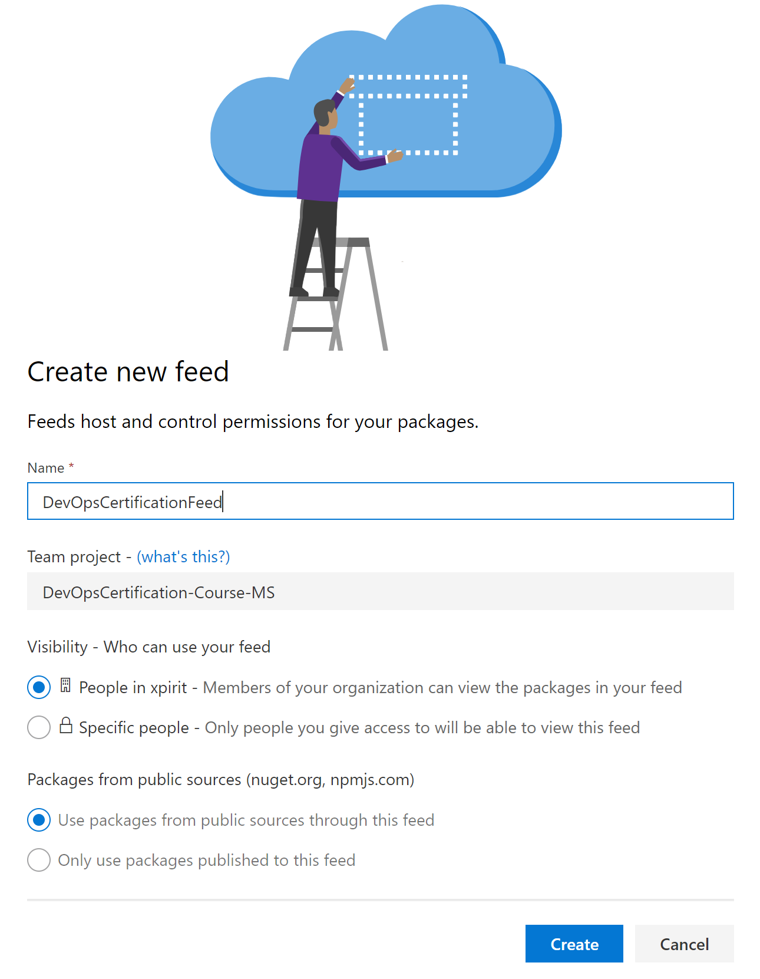
Publish packages
From Azure DevOps portal
Feeds are centralized
Specify:
Name
Visibility
Public sources as upstream

Slide 18
Module 03: Migrate, consolidating and secure artifacts

Slide 19
Identify existing artifact repositories
1
An artifact is a deployable component of your application.
2
Azure Pipelines can work with a wide variety of artifact sources and repositories.
3
Each release can specify which version of the artifacts are required.
4
Azure Artifacts can eliminate the need to manage file shares or to host private package servers.
5
Azure Artifacts provides universal artifact management for Maven, npm and NuGet.

Slide 20
Secure access to package feeds
Feeds must be secured:
Private feeds
Not allow access by unauthorized users for publishing
Restricted access for consumption:
Whenever a package feed and its packages should only be consumed by a certain audience, it is required to restrict access to it. Only those allowed access will be able to consume the packages from the feed.
Restricted access for publishing:
Secure access is required to restrict who can publish, so feeds and their packages cannot be modified by unauthorized or untrusted persons and accounts.

Slide 21
Examine permissions
Roles have certain permissions
Permission | Reader | Collaborator | Contributor | Owner
List and restore/install packages | ✓ | ✓ | ✓ | ✓
Save packages from upstream sources |  | ✓ | ✓ | ✓
Push packages |  |  | ✓ | ✓
Unlist/deprecate packages |  |  | ✓ | ✓
Delete/unpublish package |  |  |  | ✓
Edit feed permission |  |  |  | ✓
Rename and delete feed |  |  |  | ✓

Slide 22
Module 04: Implement a versioning strategy

Slide 23
Introduction to versioning
1
Packages need to be versioned
Identification
Maintainability
Each package has its own lifecycle and rate of change
2
Packages are immutable
Once published a package cannot be changed
Replacing or updating a package is not allowed
Any change requires a new version

Slide 24
Understand versioning of artifacts
Way to express version technically varies per package type
Versioning requires a scheme
Typical Scheme:
2.1.15
Major
Minor
Patch

Slide 25
Explore semantic versioning
Express nature and risk of change
1.2.3
-beta2
Nature of change
Quality of change
See also: https://semver.org

Slide 26
Examine release views
Views help in defining quality without changing version numbers
Three default views:
1
2
3
Local
Prerelease
Release
https://pkgs.dev.azure.com/{org}/{yourteamproject}/_packaging/{feedname} @{Viewname}/nuget/v3/index.json

Slide 27
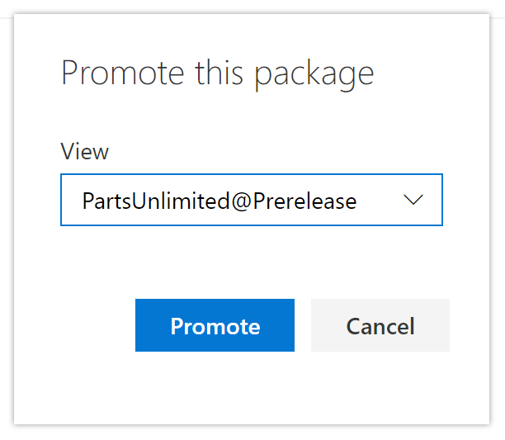
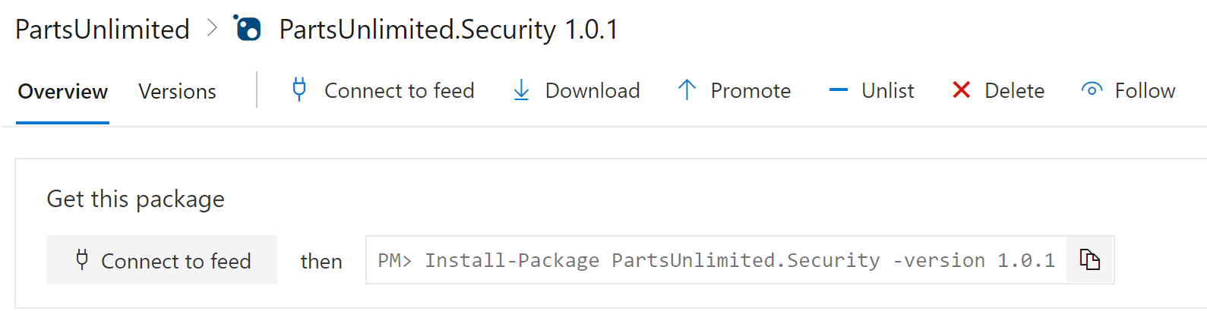
Promote packages
Promote packages from @local view to other release views.
Upstream sources will only be evaluated from @local view:
Only visible in other release views after being promoted

Slide 28
Explore best practices for versioning
1
Have a documented versioning strategy
2
Adopt SemVer 2.0 for your versioning scheme
3
Each repository should only reference one feed
4
On package creation, automatically publish packages back to the feed

Slide 29
Module 05: Introduction to GitHub Packages

Slide 30
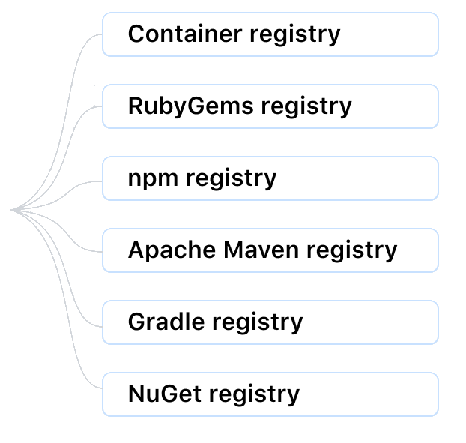
Introduction to GitHub Packages
GitHub Packages is a platform for hosting and managing packages
Combine source code and packages in one place.
Integrate permissions management and billing.
Integrate GitHub Packages with GitHub APIs, GitHub Actions, and webhooks.
Notes:
GitHub Packages is a software package hosting service that allows you to host your packages, containers, and other dependencies. It's a central place to provide integrated permissions management and billing for software development on GitHub.
GitHub Packages can host:
npm.
RubyGems.
Apache Maven.
Gradle.
Docker.
NuGet.
GitHub's Container registry is optimized for containers and supports Docker and OCI images.
You can integrate GitHub Packages with GitHub APIs, GitHub Actions, and webhooks.
https://docs.github.com/en/packages/working-with-a-github-packages-registry

Slide 31
Publish packages
GitHub Packages use native package tooling commands to publish and install package versions.
Create your token, scope, authenticate and publish.
Language | Package format | Package client
JavaScript | package.json | npm
Ruby | Gemfile | gem
Java | pom.xml | mvn
Java | build.gradle or build.gradle.kts | gradle
.NET | nupkg | dotnet CLI
Notes:
Explain about registries, and supported formats. Explain the publish process for packages.
Create or use an existing access token with the appropriate scopes for the task you want to accomplish. When you create a personal access token (PAT), you can assign the token to different scopes depending on your needs.
Authenticate to GitHub Packages using your access token and the instructions for your package client.
Publish the package using the instructions for your package client.

Slide 32
Publish packages – nuget.config
<?xml version="1.0" encoding="utf-8"?>
<configuration>
<packageSources>
<clear />
<add key="github" value="https://nuget.pkg.github.com/OWNER/index.json" />
</packageSources>
<packageSourceCredentials>
<github>
<add key="Username" value="USERNAME" />
<add key="ClearTextPassword" value="TOKEN" />
</github>
</packageSourceCredentials>
</configuration>
Notes:
Nuget.config example.
<?xml version="1.0" encoding="utf-8"?> <configuration> <packageSources> <clear /> <add key="github" value="https://nuget.pkg.github.com/OWNER/index.json" /> </packageSources> <packageSourceCredentials> <github> <add key="Username" value="USERNAME" /> <add key="ClearTextPassword" value="TOKEN" /> </github> </packageSourceCredentials> </configuration>

Slide 33
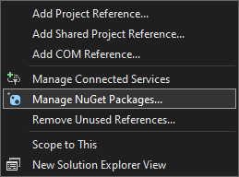
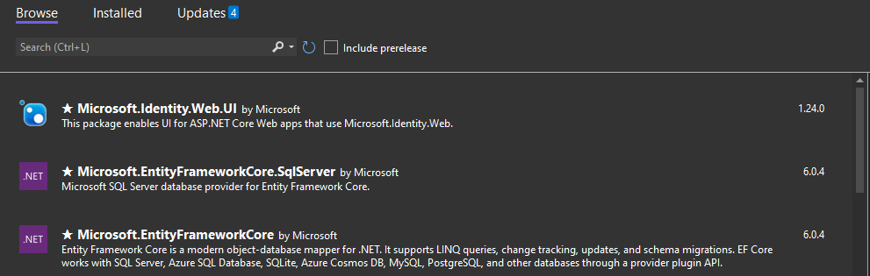
Install a package
You can install a package using any supported package client following the same general guidelines:
Authenticate to GitHub Packages using the instructions for your package client.
Install the package using the instructions for your package client.
Notes:
Explain how to install a package and that each client has its different configurations. Images show Visual Studio example of installing a package.

Slide 34
Delete and restore a package
You can delete it on GitHub if you have the required access:
An entire private package.
An entire public package, if there are not more than 5000 downloads of any version of the package.
A specific version of a private package.
A specific version of a public package, if the package version doesn't have more than 5000 downloads.
1
You can also restore an entire package or package version, if:
You restore the package within 30 days of its deletion.
The same package namespace is still available and not used for a new package.
2
Notes:
Explain how to delete and restore a package https://docs.github.com/en/packages/learn-github-packages/deleting-and-restoring-a-package#restoring-a-package-version.
You can delete it on GitHub if you have the required access:
An entire private package.
If there aren't more than 5000 downloads of any version of the package, an entire public package.
A specific version of a private package.
A specific version of a public package if the package version doesn't have more than 5000 downloads.
For packages that inherit their access permissions from repositories, you can delete a package if you have admin permissions to the repository.
You can also restore an entire package or package version, if:
You restore the package within 30 days of its deletion.
The same package namespace is still available and not used for a new package.
You can use the REST API to manage your packages.
Deleting a package version
You can delete a package version:
Deleting a version of a repository-scoped package on GitHub.
Deleting a version of a repository-scoped package with GraphQL.
Deleting a version of a user-scoped package on GitHub.
Deleting a version of an organization-scoped package on GitHub.
To delete a version of a repository-scoped package, you must have admin permissions to the repository that owns the package.
On GitHub.com, navigate to the main page of the repository.
To the right of the list of files, click Packages.
Search for and select your package.
In the top right of your package's landing page, click Package settings.
On the left, click Manage versions.
To the right of the version you want to delete, click and select Delete version.
To confirm the deletion, type the package name and click I understand the consequences, delete this version.
Deleting an entire package
You can delete a package version:
Deleting an entire repository-scoped package on GitHub.
Deleting an entire user-scoped package on GitHub.
Deleting an entire organization-scoped package on GitHub.
To delete an entire repository-scoped package, you must have admin permissions to the repository that owns the package.
On GitHub.com, navigate to the main page of the repository.
To the right of the list of files, click Packages.
Search for and select your package.
In the top right of your package's landing page, click Package settings.
Under "Danger Zone," click Delete this package.
Review the confirmation message, enter your package name, click I understand, and delete this package.
Restoring a package version
You can restore a package version from your package's landing page.
Navigate to your package's landing page.
On the right, click Package settings.
On the left, click Manage versions.
Use the "Versions" drop-down menu and select Deleted on the top right.
Next to the deleted package version you want to restore, click Restore.
To confirm, click I understand the consequences, restore this version.

Slide 35
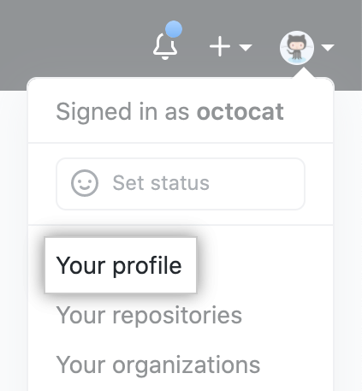
Explore package access control and visibility
Visibility and access permissions for container images:
Read:
Can download package.
Can read package metadata.
Write:
Can upload and download this package.
Can read and write package metadata.
Admin:
Can upload, download, delete, and manage this package.
Can read and write package metadata.
Can grant package permissions.
Notes:
Explain access control and visibility for GitHub Packages and container images. See https://docs.github.com/en/packages/learn-github-packages/configuring-a-packages-access-control-and-visibility for details.
You can only use granular permissions with the Container registry (scoped to a personal user or organization account).
GitHub.com doesn't support granular permissions in other package registries, like the npm registry.
You can change the package access control and visibility separately from the repository.
For more information about permissions, see https://docs.github.com/en/packages/learn-github-packages/about-permissions-for-github-packages.
Container images visibility and access permissions
If you have admin permissions to a container image, you can set the access permissions for the container image to private or public.
As an admin, you can also grant access permissions for a container image separate from your set permissions at the organization and repository levels.
You can give any person an access role for container images published and owned by a personal account.
For container images published and owned by an organization, you can provide any person or team in the organization an access role.

Slide 36
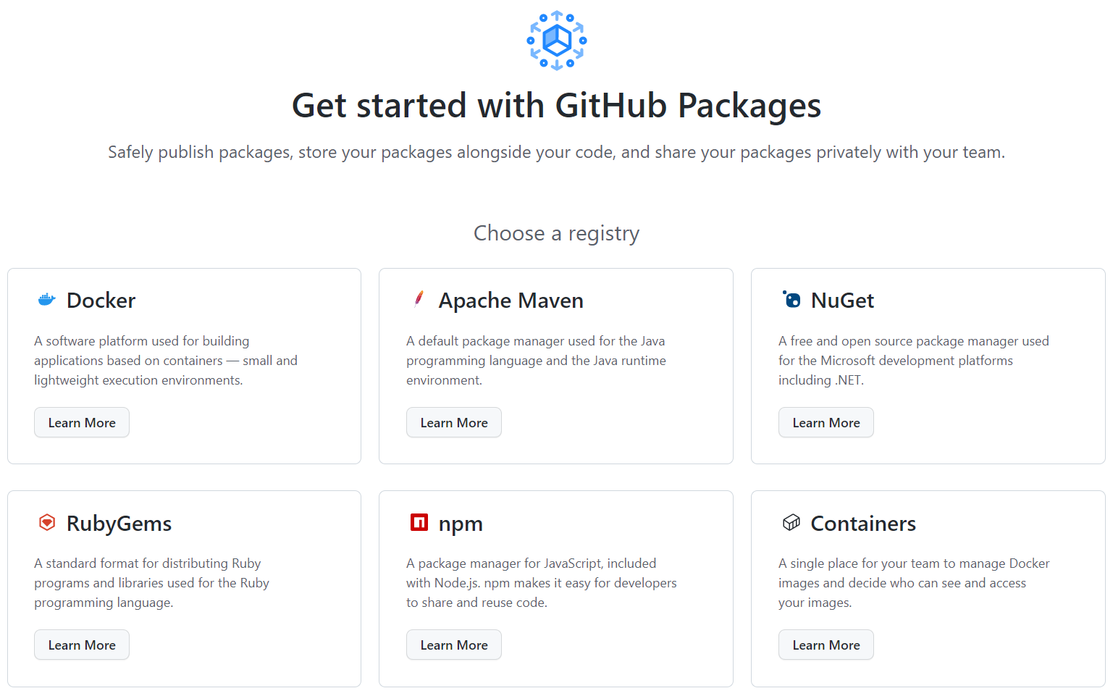
Demonstration: Install, delete and restore packages using GitHub
DEMO
Notes:
Show how to install, delete and restore packages using GitHub.

Slide 37
Labs

Slide 38
Lab: Package management with Azure Artifacts
Objectives:
Lab overview:
Create a Microsoft Entra service principal
Create an Azure key vault
Track pull requests through the Azure DevOps pipeline
In this lab, you will learn how to work with Azure Artifacts.
Duration:
Notes:
The labs are updated on a regular basis. For the latest information please visit:
https://microsoftlearning.github.io/AZ400-DesigningandImplementingMicrosoftDevOpsSolutions/

Slide 39
Closing slide

